Slide 1
GMP Cadence June 2017
Initiative 163: Disposal of Soku Produced Water via Soku017 &
Initiative 1938: BNAG Optimisation
Udoka Onuoha
WRFM Lead Swamp East Hub

Slide 2
Initiative #163: Disposal of Soku Produced Water via Soku017
Soku NAG Plant
Condensate Storage Tank
HH Water level
Water to Reinjection well
NCTL

Slide 3
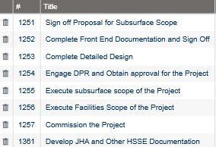
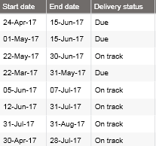






Soku Produced Water Project Status
Project Milestones
Impacts
Last Week’s actions and status
Recalculate CSD and progress to L3
CSD recalculated and project progressed to L3
Sign off BfD
BfD sign off awaiting Concept TA2 availability
Sign off proposal for sub-surface scope
Subsurface proposal sign off ongoing, awaiting one
signatory.
Engage and secure DPR approval for project
Shell DPR Liaison is following up on the approval,
daily phone calls, slow progress.
Next Week’s actions
Complete BfD Sign off
Complete Subsurface proposal sign off
Follow up DPR approval, secure engagement slot if required.

Slide 4
Initiative #1938: BNAG Optimisation

Slide 5








BNAG Optimisation Project Status
Project Milestones
Impacts
Last Week’s actions and status
Review the MRT interim report and decide need for testing of outstanding BONN029T & BONT03T
Review ongoing, deliverability test for BONN029T &
BONN023T planned to commence next week.
Agree window for testing BONN029T & BONT03T if required from PMC.
Deliverability tests for 29T & 23T planned to
commence next week, need for 29T & 3T MRT to be
determined after the deliverability test.
Handover Initiative leadership to Dev. Function nominee.
Awaiting nominee’s completion of Wave training.
Next Week’s actions
Continue 29T & 23T deliverability testing – completion timeline is two weeks.

